Slide 1
Dynamics CRM Online
Comparing Dynamics CRM and CRM Online Deployment Options
V2.27.15

Slide 2
How to use this deck…
Context for this deck
We are seeing very strong momentum of Dynamics CRM Online, particularly in competitive situations against SFDC with Sales Productivity as our hero offering!
We are also hearing a specific need to help our customers compare the value of CRM Online with on-premises. This story has two important parts:
The value of deploying in the Cloud
TCO-based cost comparisons
So, we created this deck as an initial resource on how to compare CRM Online and CRM on premises, particularly with Total Cost of Ownership in mind.
With this approach, we include key elements that go above pure price of the license to help articulate the value of the Microsoft cloud.
We describe relative merits of each deployment choice
We’ve provided research from IDC that substantiates the business value of deploying in the Cloud
What’s next?
We will have analyst-made materials and Total Economic Impact tool in Q3 and Q4.
Make sure you follow us on Yammer to get the latest!
We are also eager to hear what is needed when you are helping customers understand the Total Cost of Ownership between CRM Online and On premises.
1
2
Additional Resources
IDC’s Infographic, The Business Value of Cloud Based CRM, is available at http://aka.ms/d9lbp0
An IDC Q&A, Cloud-based CRM: Optimizing the Customer Experience, is available at http://aka.ms/cuvtb8
This deck is available at: http://infopedia/docstore/Pages/KCDoc.aspx?k=KC02-23-62011
Other useful CRM Pricing and Licensing documents are available at http://infopedia/SMSG/Pages/MicrosoftDynamics-CRM.aspx
3

Slide 3
Deployment Choice: Microsoft Dynamics CRM Server 2015
On-Premises Servers
Customer Management:
IT manages CRM in-house
IT purchases & installs software/hardware
IT provides storage, network, and datacenters to achieve global scale
Typical Deployment Approach
Deploys using virtualization or physical installation
Deploys in own datacenter
Handles all troubleshooting, updates and upgrades
Achieves compliance as required by business
Applications
Data
Customer
Runtime
Middleware
On Premises/
Private Cloud
You Manage
O/S
Virtualization
Solution Provider
Servers
Storage
Networking
Notes:
On Premise deployments are the deployment approach that most customers are familiar with as many of the took this approach over the last 20 years or so with the rise of client server computing. As virtualization started to rise we saw more customers consolidate physical servers and run many virtualized instances on a single physical server hardware. This was often referred to as a Virtual Private Cloud.
With this approach IT maintains a high level of control of their server infrastructure including purchasing of hardware, installing the hardware , software, storage and network. However, the cost associated with IT headcount, software, network, Disaster Recovery, High Availability, patching and upgrading becomes one that the business must fully absorb, these factor into an organizations CAPEX costs. Further, the organization must think about the time an effort required to address global business needs.
It’s often more expensive to scale out (build datacenters or lease space) , scale up (add more resources as usage and load demands require – you have to wait for procurement, installation, test, then finally live), further, you need to work with auditors and have compliance staff in place to ensure that you are meeting the regulatory needs placed on your business both domestically and internationally. Once live, how do you scale down to reduce your spend when resources are no longer needed? In this case you still need to absorb the CAPEX costs.
While this approach continues to serve many businesses well, in todays fast moving market you need to ask yourself “Will they continue to serve me for the future? Keep me competitive? And allow me to get IT working on strategic initiatives for the business?” or Will you continue to keep the lights on while your competition goes broader, faster and at lower costs?

Slide 4
Deployment Choice: Microsoft Dynamics CRM Online
Microsoft-Hosted and Managed
Microsoft Management:
Delivers a complete SaaS service
Secures and manages for customer
Provides global datacenters, hw/sw, networking to customer
Manages application, hardware, network
App/Data accessible to customer
Microsoft Deployment Approach:
Deploys instantly into Microsoft’s Global Datacenters
Certifies & ensures compliance for Commercial & Government Customers
Integrates CRM Online with Office365 & Azure for ease of use and single sign on
Works with customers on major application upgrades
Applications
You Access
Data
Runtime
Microsoft
Public Cloud SaaS
Middleware
O/S
Manage by Microsoft
Dynamics CRM Online
US Government Cloud for CRM
Virtualization
Servers
Storage
Networking
Notes:
The final option for running CRM is use Dynamics CRM Online which is a complete SaaS solution. SaaS solutions are finished services that are made available to a customer at a single price typically per user by month or by year. Dynamics CRM Online includes the software license, the management of the service, maintenance, application upgrades, use of the latest hardware, high availability and disaster recovery.
In the case of CRM Online, Microsoft provides all of the aforementioned options in it’s offer including a 99.9% financially backed SLA and also handles a number of Compliance Certifications required by local governments for customers do business in these markets. We provide a modern Generation 4 infrastructure with Global Datacenters around the world. We have invested Billions of dollars to deliver world class infrastructure. Even as we continue to expand our datacenter footprint our prices remain the same. In addition, we have 3rd party penetration testing to ensure that are services are secure and we follow strict processes regarding access to information and privacy. Further, we do the heavy lifting to ensure integration with our other cloud services including Office365, Yammer, Exchange and Azure (for building custom line of business cloud apps that want to integrate with CRM Online)
Additionally, our U,S. Government customers have special requirements that differ from Commercial customers. We have invested in datacenters that meet the strict compliance and regulatory requirements of these agencies.
For a deeper view on CRM Online please take your customer through the complete deck for Understanding CRMOL for IT Leaders
KEY BENEFITS OF GOING WITH MICROSOFT CRM ONLINE IN OUR PUBLIC CLOUD:
Speed to Value. Get up and running faster, implement enhancements quicker, realize value sooner.
Cost predictability. Pay-as-you-go pricing that allows you to change capital expenditures into predictable operating expenses.
Continuously Available. Application and Infrastructure Management is handled for you and backed by a guaranteed, financially backed SLA of 99.9%. Access anywhere using a browser, work offline with Outlook integration.
Use Modern, High Performing Infrastructure. We have invested billions in our state of the art datacenters to deliver the best user experience.
Ready When You Are. Capacity to grow as fast as your business can go. Deploy CRM quickly; expand globally in an instant; add users at a moment’s notice.
Secure, Compliant, Redundant. 3rd party testing, regulatory compliance to address global business needs. Multiple copies of your data and instance to prevent outages. We do the heavy lifting so you don’t have to.
No Compromise on Dev & Test. Dev & Test on the same configuration and hardware as Production. More than 25 licenses gives you a free sandbox environment
Maintain Flexibility. Customize as needed for your business. UI, Entities, Activities, Dashboards, Workflows. Tons of flexibility
Transform IT, Deliver Higher Value. Focus IT on strategic efforts to achieve better business alignment by reducing complexity associated with hardware, software, support, update, backup or tech training activities. Microsoft manages, allowing customers to focus on their core business strengths.
Integrated with Office365 for ease of us

Slide 5
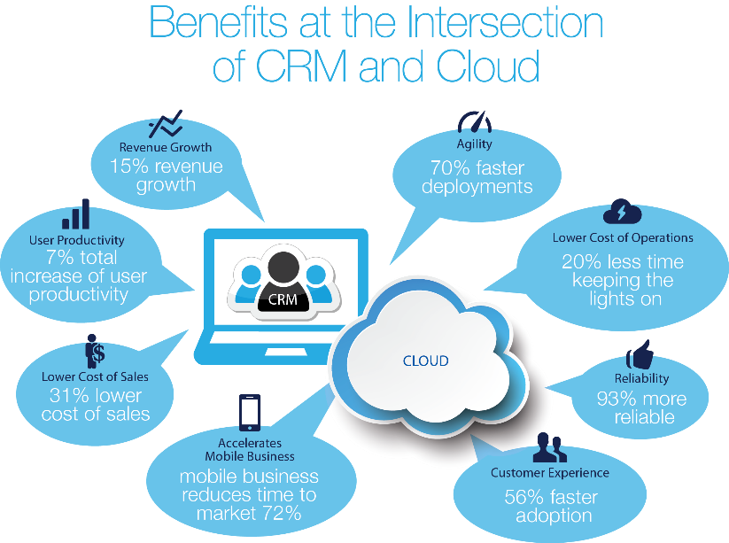
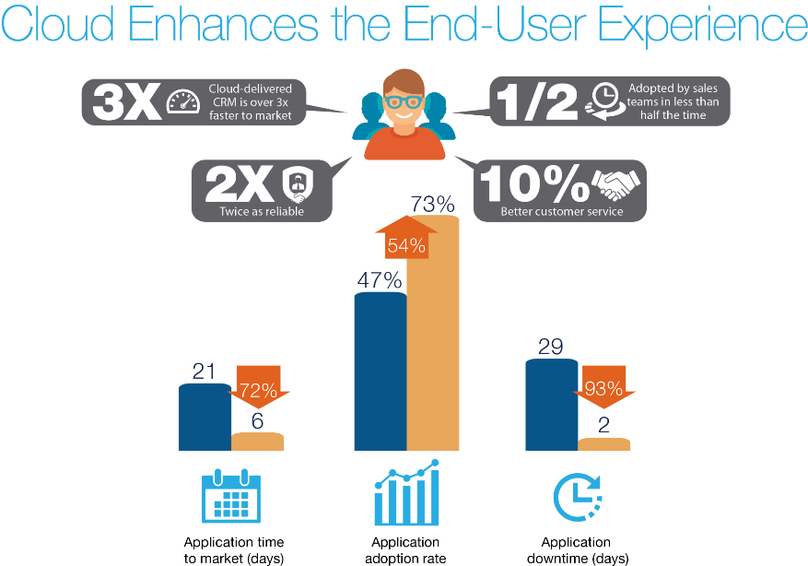
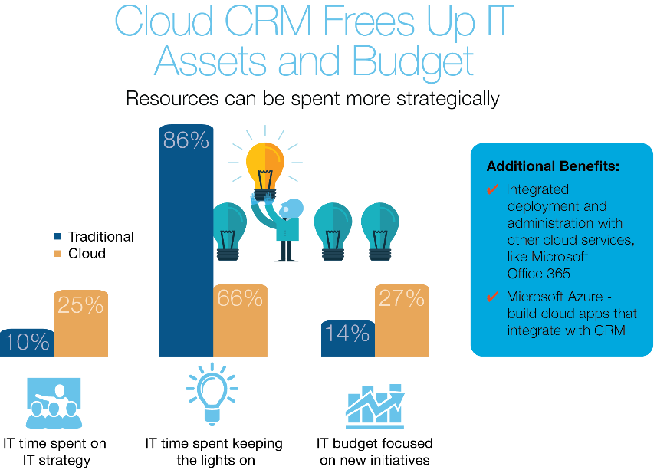
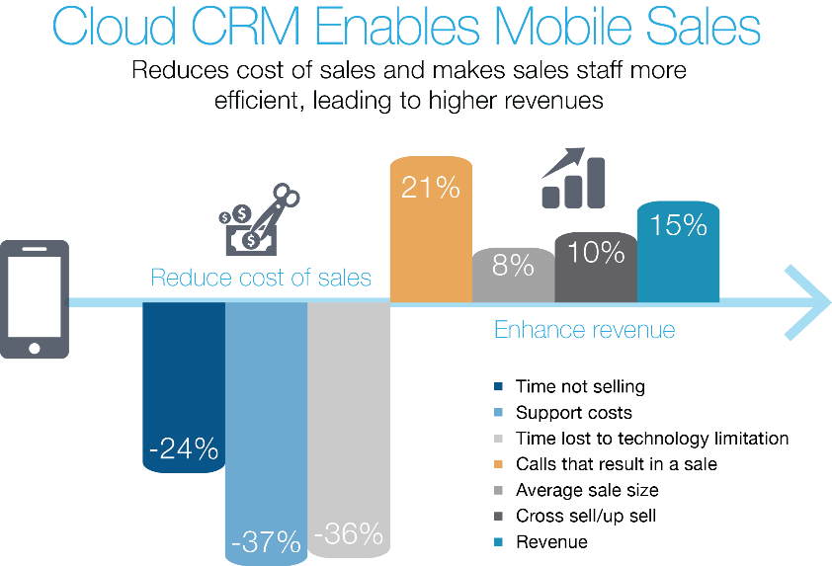
The Business Value of Cloud Based CRM
Benefits at the Intersection of CRM and the Cloud
Cloud CRM Enhances the End-User Experience
Benefits at the Intersection of CRM and the Cloud
1
3
Cloud CRM Frees Up IT Assets and Budget
Cloud CRM Enables Mobile Sales
2
4
© IDC
Notes:
When evaluating deployment decisions, it’s important to recognize the full business value of deploying a Cloud-Based CRM Solution. IDC has recently released some research that quantifies this business value. At a high level, we see a lot of benefits at the intersection of CRM and the cloud. CRM lowers cost of sales while increasing revenue and productivity. Cloud helps you realize those benefits more quickly and with greater reliability. Let’s drill into some of those subject areas:
Deploying CRM in the Cloud frees up IT Assets and Budget, allowing customers to spend IT resources more strategically. Shifting to the Cloud allows IT staff to spend twice as much of their time on IT strategy. IT staff spends 20% less time on routine service maintenance. Cloud cost savings double budget available for new initiatives. Also, Cloud CRM offers additional opportunities and efficiencies when integrating with other cloud services. Whether it’s a common administrative experience with Microsoft Office 365, or integrated applications with Microsoft Azure, a cloud CRM deployment becomes even more valuable as part of a larger cloud strategy.
Cloud CRM enhances the End-User Experience. Customers deploy Cloud CRM three times faster. 54% more of sales staff will adopt it, and in roughly half the time. Once deployed, users will enjoy 93% less service down time and a better customer service experience.
Finally, Microsoft’s mantra of Cloud First, Mobile first, is particularly applicable to the needs of mobile sales teams. Cloud CRM reduces costs of sales by increasing time spent selling, reduces support costs, and reduces time lost to technology limitations. On the other hand, Cloud CRM increases the number of calls that result in a sale, average sale size and cross sell/upsell success, resulting in a 15% revenue increase.
So as you can see, benefits of deploying in the cloud extend beyond a simple expense comparison. Let’s take a look at the rest of the value comparison between on-premises and online deployments.

Slide 6
Sales Productivity helps to see more than the tip of the iceberg
When positioning online to on-premises, make sure you dive deeper than pure license price!
CRM Online
Sales Productivity
On-premises
Example
License Price
i.e. how much a user pays for rights to access the solution
$45 ⁽¹⁾
$35 ⁽²⁾
Online-only functionality
i.e. Power BI, Social Engagement, Inside View, Sales Collaboration Portal
Included
$20 + $20 + $99 + $2 ⁽³⁾
Based on add-on pricing
Hosting
i.e. Data Center Capex and Opex
Included
$20
Conservative estimate based on commercial service provider hosting charges
The Business Value of Cloud Based CRM
Included
Not included
Suggest comparing with market specific vendors
Upgrades, SLA, privacy, security and support
Refer to Dynamics CRM Trust Center
Included
Not included
Suggest looking at market specific vendors
Additional Software
i.e. CRM Server, Windows Server and SQL Server?
$0
$2
Based on average 800 users;
Higher per user costs at smaller deployments
(1) Includes Dynamics CRM Online and Power BI. Net promotional prices after discounts applied. Shown per user per month in USD.
(2) Price per user license per month, for EA Level A L&SA over 36 months.
(3) Power BI ($20) add-on for E3/ E4 subscribers; Social Engagement ($20) add-on for CRM on-prem Pro CAL; Inside View ($99); Sales Collaboration Portal ($2) add-on to CRM on-prem Pro CAL.

Slide 7
Sales Productivity Is Available in Direct & Volume Licensing
Direct Channel
Volume Licensing
Example
Microsoft Dynamics CRM Online Professional
+
Power BI
+
Office 365 Plan E3
$65*
/user/month
Microsoft Dynamics CRM Online Professional
+
Power BI
$45*
/user/month
Add-on to O365 E3/E4
Microsoft Dynamics CRM Online Professional
+
Power BI
+
Office 365 Plan E3
$62**
/user/month
No Level Price of $20 for O365 E3.
Additional discounts on O365 E3 may apply. Level A Com.
Pricing on BI & CRMOL
Microsoft Dynamics CRM Online Professional
+
Power BI
$42**
/user/month
Add-on to O365 E3/E4
Level A Commercial Pricing
(*) Net promotional prices after discounts applied. Shown per user per month in USD.
(**) Actual pricing in Volume Licensing will vary by customer waterfall level, geography, and channel. See pricing details that follow.

Slide 9
Appendix

Slide 10
Sales Productivity Terms & Transactional Considerations
These offer IDs are no longer valid for transacting Sales Productivity in Volume Licensing and should not be used going forward:
DSD-00046 DynCRMOnlnPro ShrdSvr ALNG SubsVL MVL SalesProdPromo PerUsr Restricted)
DSD-00045 DynCRMOnlnPro ShrdSvr ALNG Subs MVL Rstrctd PerUsr forSASalesProdPromo
7YY-00016 PowerBI ShrdSvr ALNG SubsVL MVL Promo PerUsr forE3/E4 (Note: This SKU may still be active and used for other promos.)
CRM Promo Duration through June 30, 2015.
Geographies: Everywhere Microsoft Dynamics CRM Online, Office 365 and Power BI are sold
Programs: EA, MOSP, MPSA.
Future price tables should be set at regular price. Sales Productivity discounts on future pricing will not be approved.
Customers may purchase additional seats leveraging sales productivity discounts during the promo period. Please note the following regarding additional orders:
Incremental seats must meet the same qualification requirements as initial orders.
Incremental orders should be done through a supplemental price sheet.
Component pricing, but not total solution cost, is subject to change during the promotion period.
Promo pricing is granted for only the order quantity purchased during the promo period and promo pricing on those seats lasts for the duration of the agreement.
Also available for Dynamics CRM Professional USL for SA licenses (requires active SA for CRM Pro CAL)
Not available for CRM Online Basic or Essential
Commercial and Government
PowerBI is not GCC compatible. Government pricing is being applied to a commercial tenant.

Slide 11
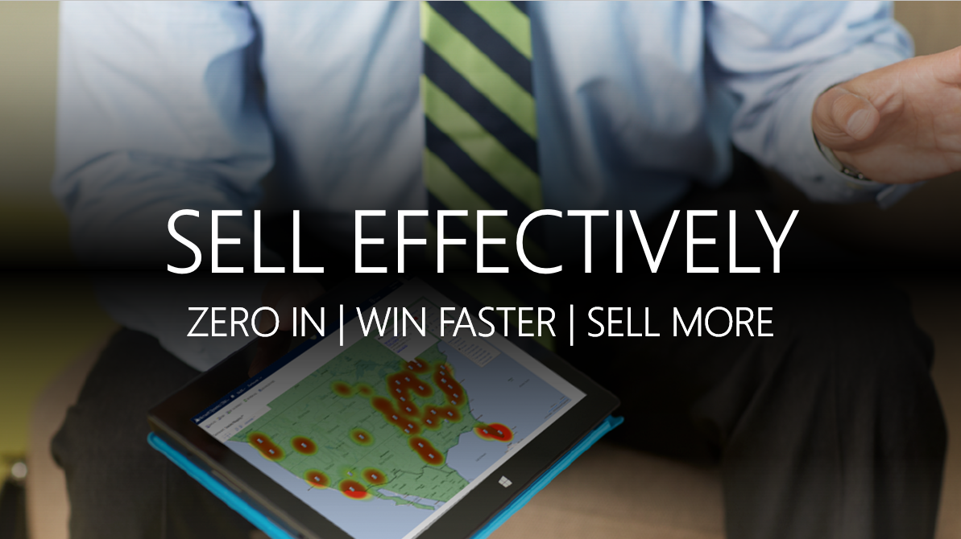
Battle Card: Microsoft Sales Productivity
MICROSOFT SALES PRODUCTIVITY: WHAT IS IT?
TOP LINE MESSAGING
MICROSOFT SALES PRODUCTIVITY: WHAT IS INCLUDED?
Microsoft delivers the most comprehensive sales productivity solution that combines Microsoft Dynamics CRM Online, Office 365 and Power BI for Office 365 to create the most modern experience to help sellers deal with the challenges they face today while providing the highest value.
Microsoft sales productivity enables organizations to empower their people, so they can effectively engage with customers and exceed expectations. By delivering amazing customer experiences, businesses will thrive.
Microsoft sales productivity helps sellers zero in on the best leads, sell with network intelligence, turn insights into advantage, find the right content quickly, create winning presentations, and bring together the right people to close deals faster.
Managers can track business health, engage in strategic deals and drive best practices across the organization to develop top performers.
Microsoft Dynamics CRM Online is a market leading business solution that helps companies market to, sell and service their customers quickly and easily through social insights, business intelligence, and an outcome-driven user experience in the cloud, for an unbeatable value.
Office 365 is our cloud-based best-in-class productivity solution that Microsoft customers know and use every day. Powered by the cloud, customers can work with their team to collaborate from virtually anywhere on any device. Integration with CRM—SharePoint documents, inline Yammer, Lync availability and Skype in the app—enables customers to work effectively within the context of their work.
Power BI for Office 365 provides an organization-wide self-service business intelligence (BI) infrastructure that enables you to visualize both internal and external data and develop fresh insights without having to be a business analyst, and we do in an extremely cost effective manner.
MSFT ADVANTAGES
Integrated Productivity & Collaboration
Unmatched Value
Trusted Cloud Solution
Social Analytics in CRM
VALUE PROPOSITION: Microsoft helps SALES TEAMS ZERO IN, WIN FASTER AND SELL MORE
Increase time selling. Eliminate app-flipping, engage sales reps with contextual information in simple user experiences that add value to the selling process. Work the way you want to work, on the device you choose, wherever you are.
Reduce prep time. Provide social and business insights and connections that make every customer conversation more relevant, valuable, and productive. Gain access to the people, content, and information you need to collaborate, refine, and win.
Sell more using collective intelligence. Leverage your network to find the right information at the right time. Enhance your account and opportunity information with contextual social insight and engage in team selling with social productivity. Improve your account, lead and contact information to build relationships and personalize every customer interaction.
Gain visibility to improve the health of your business. Evaluate sales pipeline health with confidence. Better data and familiar analytical tools means better insights, understanding, and confidence.
Engage & collaborate around strategic deals. Access the people, information, and content needed to turn insight into closed deals and revenue.
Develop a team of ‘A’ players. Process flows drive best practices across your organization while allowing you to drive consistency and remain agile so you can deliver the best customer experience. Reduce onboarding time of new reps, coach developing reps, and share best practices across the team. Analytics help identify top performers.
Power BI
KEY SALES PRODUCTIVITY FEATURES THROUGH ANY BROWSER OR DEVICE
In-context social feed
Flexible, collaborative workspace for teams
Find related documents, conversations, and people
What-if analysis and data exploration
Document management
Real-time presence, Instant Messaging, conferencing
Sales quota / goal / forecast management
Process driven UI
Embedded social insights
Social listening and analytics
Power BI for Office 365
Seamlessly run desktop and modern LOB applications
Enterprise security and manageability
Breadth of devices and peripherals for all scenarios
Share live reports and custom data sets
Sales analytics and planning
Access to insights through dynamic visualization

Slide 12
Battle Card: Microsoft Sales Productivity
Why Choose Microsoft Sales Productivity vs. SFDC & Google
DISCOVERY QUESTIONS
Process-driven user experience helps sellers focus on business results and enables business’ multi-process agility and flexibility
Insights real time with InsideView (US) included with CRM OL license
Collaboration for team selling with Yammer, SharePoint and Lync interoperability simplify working across and beyond the sales team to close business
Inline dashboards and data visualization everyone can use to make it easy for sellers and sales managers to analyze forecasts and what-if scenarios
Mobile apps across devices with offline access to recently viewed records at no additional charge
Customizable lead-to-opportunity conversion process
Essential account / prospect information on a single screen, no scrolling or app flipping
Social for everyone included in user price
When speaking with a CIO or an IT Professional:
Who within your organization is most concerned with sales productivity? Will you set up an introduction for me?
Is your CRM system easy to adapt to your changing needs? When sales processes change, how do you roll these changes out to your sales team?
Has your organization considered cloud-based solutions? What processes are currently in the cloud or are being evaluated for cloud?
Would you say your current CRM system is delivering an excellent return on investment for your organization?
When speaking with a BDM i.e. VP of Sales:
Are your sales professionals social sellers?
What percentage of your salespeople’s time is actually spent selling? Describe a typical morning for one of your sellers.
What are some of the issues that keep your salespeople from being able to do their jobs efficiently?
Do salespeople have easy access to the tools and information they need, in the field or in the office?
Do you know what your customers are saying about you?
COMPETITIVE PRICING & LICENSING
 |  | Microsoft | Salesforce.com Enterprise Edition
Office 365 (E3) | Email, Calendar | ● | Google Apps
 | IM and presence | ● | Chatter Messenger
 | Screen Sharing and message archiving | ● | N/A
 | Online conferencing with voice and HD Video | ● | Cisco WebEx
 | Office 365 Pro Plus on any PC or device | ● | N/A
 | Enterprise social network | Yammer | Chatter
Power BI | Data exploration and “what-if” analysis | ● | N/A
Dynamics CRM Online Professional | Sales automation | ● | ●
 | Process-guided user experience | ● | N/A
 | User driven analytics (Excel connection) | ● | N/A
 | Mobile apps across devices (Win8, Android, iOS) | ● | ● (No Win8)
 | Dashboards / Reports | ● | ●
 | Social Insights | ● (InsideView) | Data.com +$125
 | 99.9% Financially-back SLA | ● | N/A
 | Data storage | 5GB | 1GB
 | Social listening | ● (MS Social Listening) | Radian6 + $???
Total Cost Per User Per Month |  | $65 | $255 +
ACCOUNT TARGETING & CUSTOMER PAIN POINTS
Target Audience are customers that:
See the value in improving their sales teams’ ability to collaborate and drive toward desired outcomes to rapidly grow the business and drive sales.
Need better visibility into their customer data to be able to effectively manage and prioritize customer leads/opportunities, to drive sales alignment, and increase revenue.
Want to buy from an industry leader who provides most trusted solution with the lowest TCO and the best value on market.
Target Contact within customer:
Business decision makers (BDMs) in sales, VP of Sales and Sales Operations, CEO/COO
CFO and CIO with business in mind, looking at financials for best value and ROI
Productivity Pain Points:
Difficulty prioritizing work
Information spread across multiple sources
Ineffective, outdated sales approaches
Inconsistent engagement and execution
Inability to access data while on the go
Need instant access to the right resources and people
Sales Productivity Overview

